Slide 1
Notes:
A warm welcome to Xamarin Dev Days.
Super awesome – packed with some amazing content – slides docs and some demos.
Each of these sessions are about 40 – 50 minutes.
First one probably a little bit lengthy because we are giving a complete overview of Xamarin & Introduction to Xamarin Dev Days itself.
How many are brand new to Xamarin?
How many people are doing things for a while.

Slide 2

Who’s this guy?
Harikrishnan
Product Lead – Syncfusion
harikrishnann@syncfusion.com
https://www.syncfusion.com/products/xamarin
Notes:
I first and personally thank each and every one of you for taking time to actually dedicate listening my presentation for Xamarin Dev Days event.

Slide 3
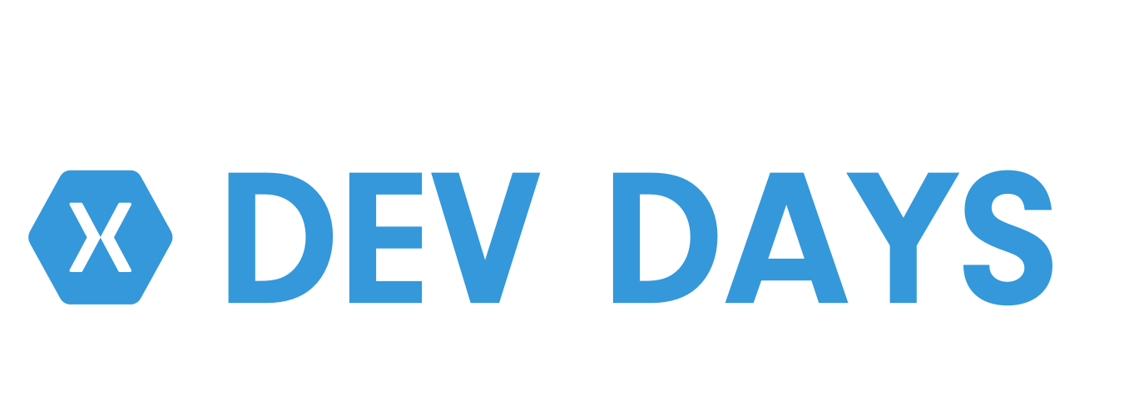
Agenda
Introduction to Xamarin
Cross Platform UI with Xamarin.Forms
Connected Apps with Azure
Lunch – Courtesy of Sponsor
File -> New App Workshop
Notes:
The day is broken up into morning & afternoon. Complete overview of Xamarin.
Each sessions are about 40 – 50 minutes and we will take breaks between each of them before lunch.
Introduction to Xamarin – We are gonna talk about the Xamarin, Xamarin platform, crafting needed iOS, Android and Windows Apps.
And then, we gonna take a look @ Xforms which brings in Cross-platform UI in a whole nice MVVM framework is very nice & set on top of Xamarin platform.
And then we gonna take a look at building Connected apps using Azure – Mobile apps which is really a cool way of adding backend to your front end.
And then we will take a lunch which is sponsored by Syncfusion Software.
And finally, after lunch, you have to stick around. We help you do a File -> New App Workshop – where we will be building around first application from scratch.

Slide 4
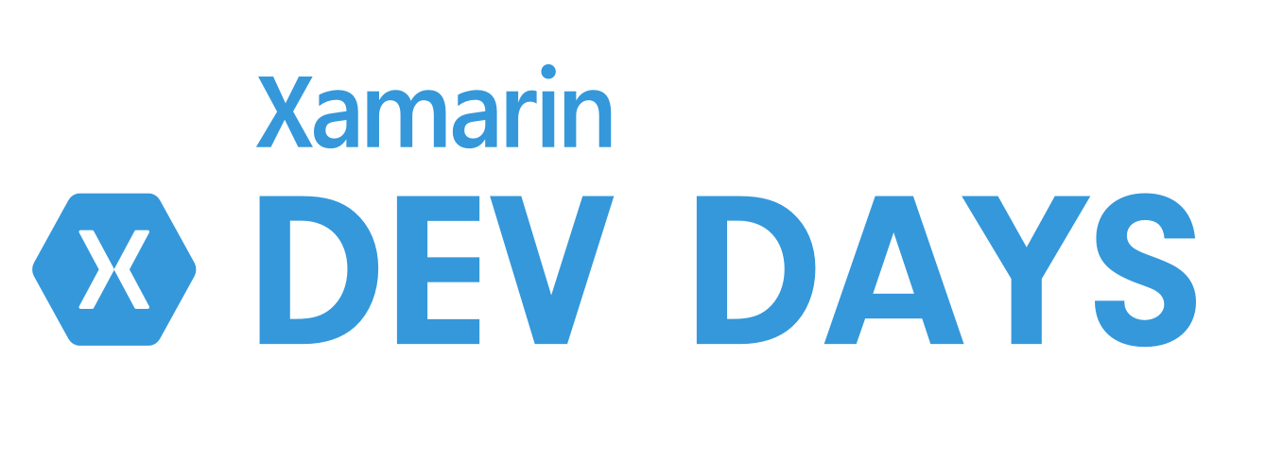

Slides, Demos, & Lab - Clone or Download:
http://github.com/xamarin/dev-days-labs

Slide 5
Sponsor
Syncfusion.com
#XamarinDevDays
Notes:
Develop custom components using Xamarin.
90+ control in Xamarin
Our components target Xamarin.Android, Xamarin.iOS & Xamarin.Forms

Slide 6
Native iOS & Android Development with Xamarin
Harikrishnan
Notes:
So the first thing we are gonna talk about is the Native iOS & Android development with Xamarin.
So building using our C# and .NET skills to built & craft Native Anddroid & iOS apps with Xamarin C#.

Slide 7
Architecting Mobile Apps
Notes:
So we know what we want
How do we get there?
Let’s talk about the state of mobile development.

Slide 8

Xamarin’s Unique Approach
iOS C# UI
Android C# UI
Windows C# UI
Shared C# Mobile
• Shared C# codebase • 100% native API access • High performance
Notes:
Xamarin enables you to build the shared C# mobile backend of your business objects of apps, models, viewmodels, rest service calls, SQL databases in .NET code that can run anywhere.
Xamarin allows you to develop Android & iOS apps using C# at the same time, gives you all the tools to build to compile everything inside VS.
100 % native API access and High performance on par to native.

Slide 9
Windows APIs
Microsoft.Phone
Microsoft.Networking
Windows.Storage
Windows.Foundation
Microsoft.Devices
System.Net
System
System.IO
System.Linq
System.Xml
System.Data
System.Windows
System.Numerics
System.Core
System.ServiceModel
C#
Notes:
If you are a windows developer, that the .NET runtime, .NET framework is running somewhere on some windows machine & bundled into your application.
When you wanna get platform specific APIs whether it is Windows 10, Windows Phone or ASP .NET, you can get those APIs of that platform.

Slide 10
iOS – 100% API Coverage
MapKit
UIKit
iBeacon
CoreGraphics
CoreMotion
System.Net
System
System.IO
System.Linq
System.Xml
System.Data
System.Windows
System.Numerics
System.Core
System.ServiceModel
C#
Notes:
Now think of it when it come to Android & iOS development in Xamarin, you still get all the .NET goodness on the bottom.
But instead of running on the .NET runtime, Xamarin enables all the .NET code to be run on the MONO runtime which is bundled into applications.
And then you get the BINDINGS of every single API in iOS & Android.

Slide 11
Android – 100% API Coverage
Text-to-speech
ActionBar
Printing Framework
Renderscript
NFC
System.Net
System
System.IO
System.Linq
System.Xml
System.Data
System.Windows
System.Numerics
System.Core
System.ServiceModel
C#
Notes:
Now think of it when it come to Android & iOS development in Xamarin, you still get all the .NET goodness on the bottom.
But instead of running on the .NET runtime, Xamarin enables all the .NET code to be run on the MONO runtime which is bundled into applications.
And then you get the BINDINGS of every single API in iOS & Android.

Slide 12
Building User Interfaces
Notes:
So we know what we want
how do we get there?
Let’s talk about the state of mobile development.

Slide 13



Traditional UI approach
iOS C#
Android C#
Windows C#
Shared C# Logic
3 Native User Interfaces
Shared App Logic
Notes:
So often when you are building apps, you want a beautiful UI & access to all the native APIs. You usually may think that you have to go down to building in iOS apps & Objective C or swift with X-Code on a mac. And for Android using JAVA and Android Studio or Eclipse.
And you get great native experiences on each platform. But everything in different language, different IDE, different development environment, different tools, multiple teams, really expensive.
You cannot ship the same feature on each platform without duplicating same works. Each people work on same work to get one output.
This is where you know, SILO approach seems to have great native apps but are not sharing anything, unlike write once & run everywhere when I go for Cross-Platform.

Slide 14
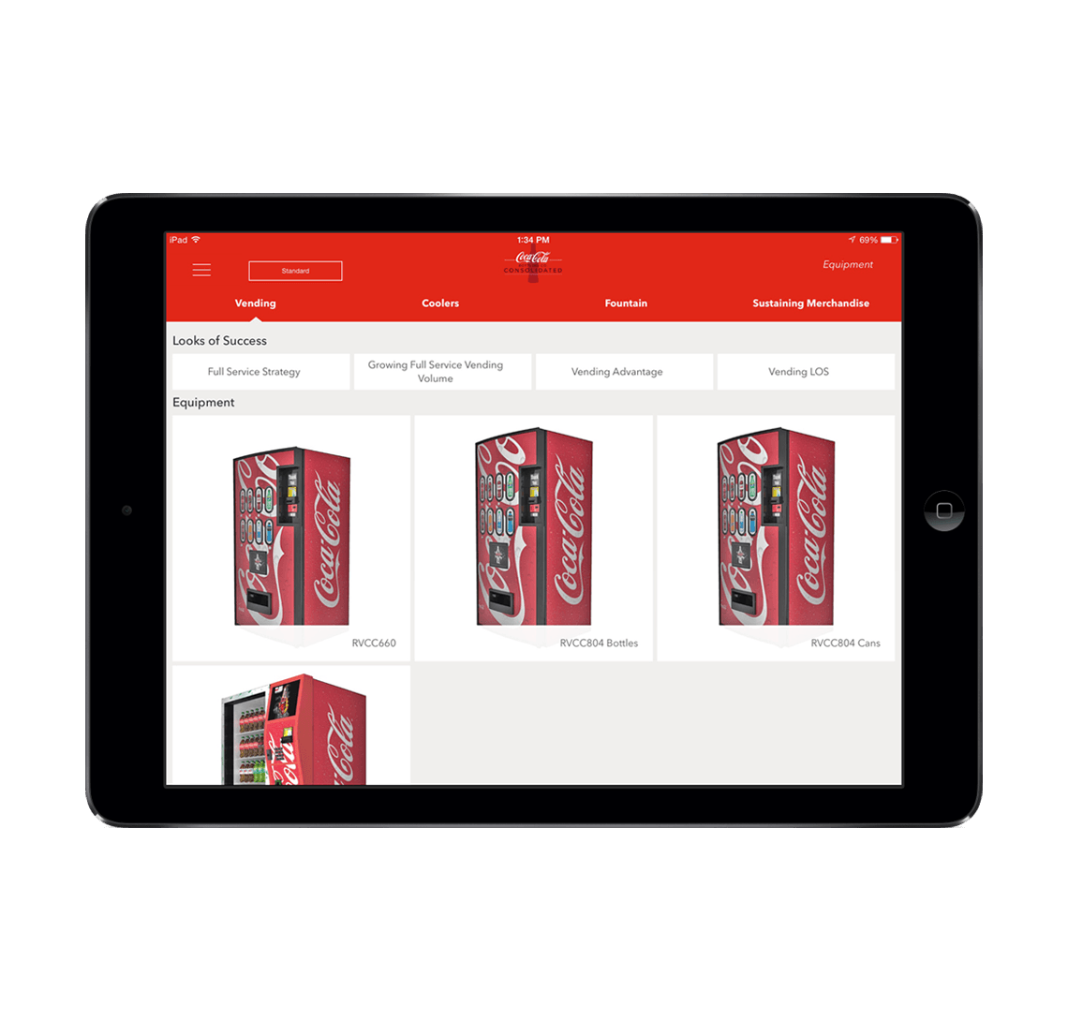
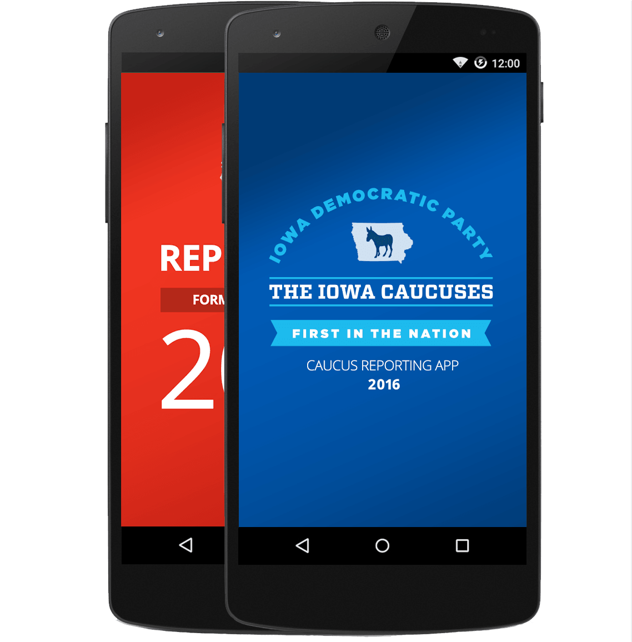
Xamarin.Forms approach
Shared UI Code
Shared C# Logic
Shared User Interface
Shared App Logic
Notes:
This is where Xamarin is completely different.
Xamarin enables you to build the shared C# mobile backend of your business objects of apps
Craft a beautiful UI for iOS & Android in Windows inside a VS and access all the native APIs from C#.
So your are sharing 50 – 80 % of your code across all platforms with 100 % APIs access.

Slide 15
UrhoSharp
CocosSharp
Notes:
Many popular and powerful game engines already leveraging C# are lifted by Mono runtime move to MIT license

Slide 16
Code sharing stats
iCircuit
Touch Draw
Android
iOS
Mac
Windows
Notes:
An average developer shares 70 % of code across each platform when building with traditional approach.
All these are code sharing statistics when you building things out.

Slide 17
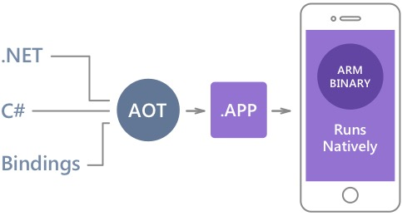
Native Performance
Xamarin.iOS does full Ahead Of Time (AOT) compilation to produce an ARM binary for Apple’s App Store.
Xamarin.Android takes advantage of Just In Time (JIT) compilation on the Android device.
Notes:
Where Xamarin really differentiates is because of its true native performances.
Xamarin apps do not cross compile. They have their own compiler, linker & optimizer for both Android & iOS to go through their own passes to surely build a native assembly at the end of the day.
On iOS, they do a full ahead of time compilation to produce an ARM binary – same kind of processes that Objective-C & Swift apps does.
This C# compiles it to IL, to have a byte code again goes to a compiler and optimizer.
On Android things are bit different. Thinks do not have to be ahead of time compile, because android turn around apps in lot of VM or Dalvik runtime.
Xamarin actually runs the mono-runtime side by side. They do have a super fast JIT compilation process.

Slide 18
✓Always Up-to-Date
Same-day support:
iOS 5
iOS 6
iOS 7
iOS 8
iOS 9
iOS 10
Full support for:
Apple Watch
Android Wear
Amazon Fire TV
Google Glass
and much more
Notes:
What is so awesome is Xamarin is always up-to-date.

Slide 19
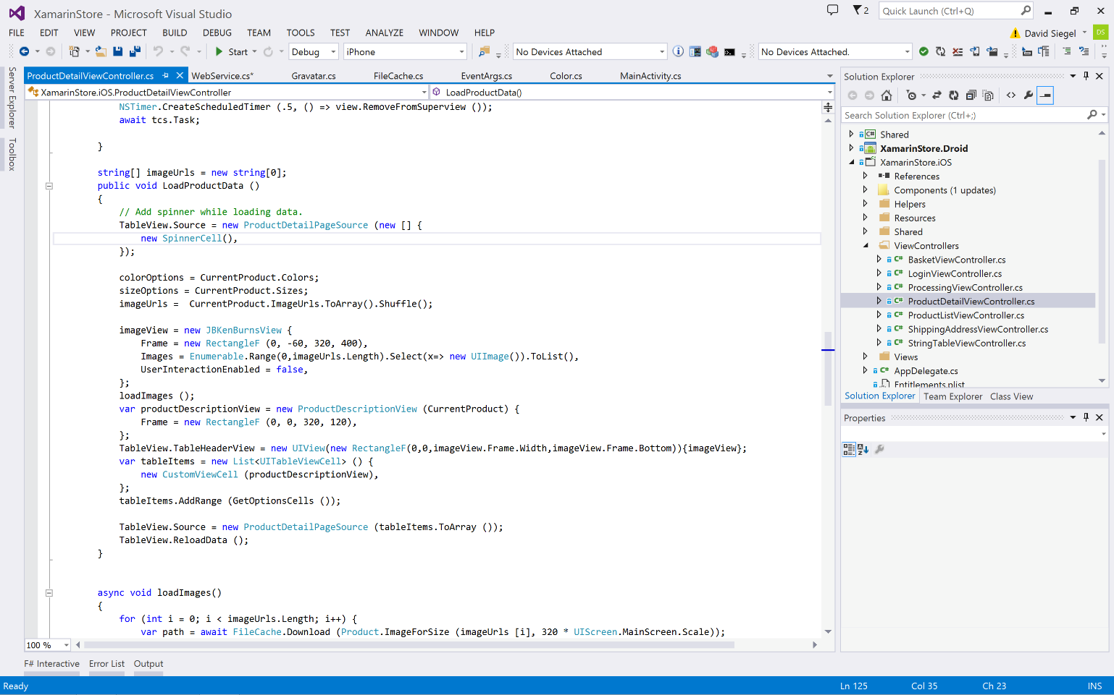
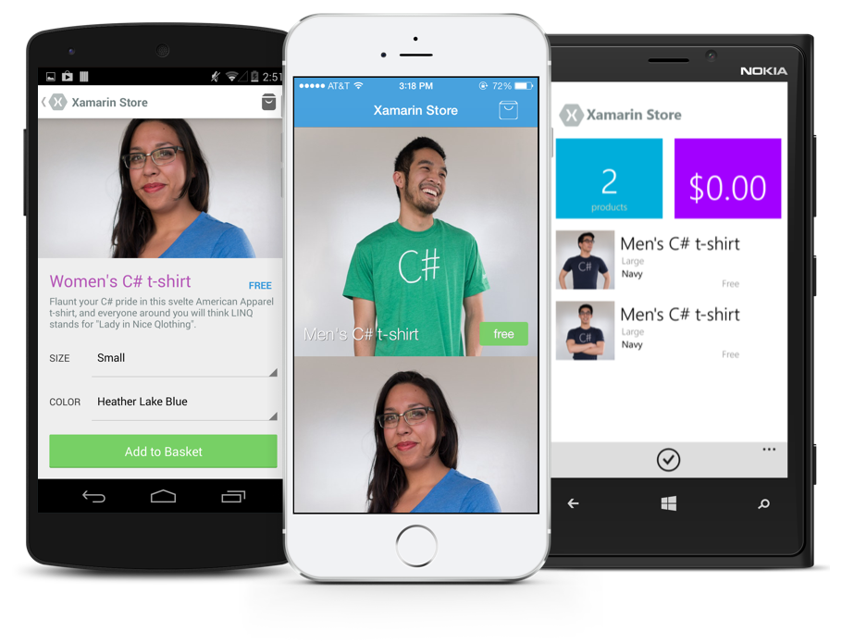
Anything you can do in Objective-C, Swift, or Java can be done in C# with Xamarin.
Notes:
Anything you do in Objective-C, Swift or Java, can be done in C# and VisualStudio with Xamarin.
Coming up next is bubbles

Slide 20
Development Experience
Notes:
One of the awesome things about Xamarin is the great development experience.
So before we go and actually code & look at the sample, how to actually build this stuff?
Where we gonna be working on every single day?

Slide 21
Xamarin is included
in Visual Studio
Including Community Edition!
Notes:
Xamarin is included in VS in all editions including community edition @ no additonal cost.
Community edition is free, so if you are a small independent or small starter, its absolutely free.

Slide 22
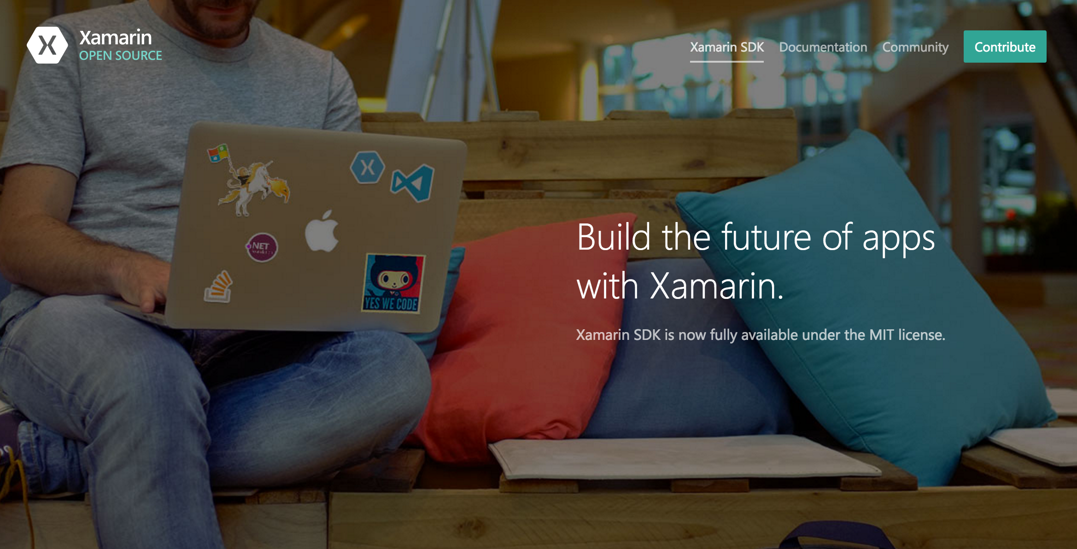
Open Source – open.xamarin.com
Notes:
Onething also to mention, is that all Xamarin SDKs are completely open source.
Xamarin, iOS, Android, Xamarin.Forms, components & widgets, all these things are open sourced. You can take a look @ how these are all build up and start contributing to Xamarin.

Slide 23
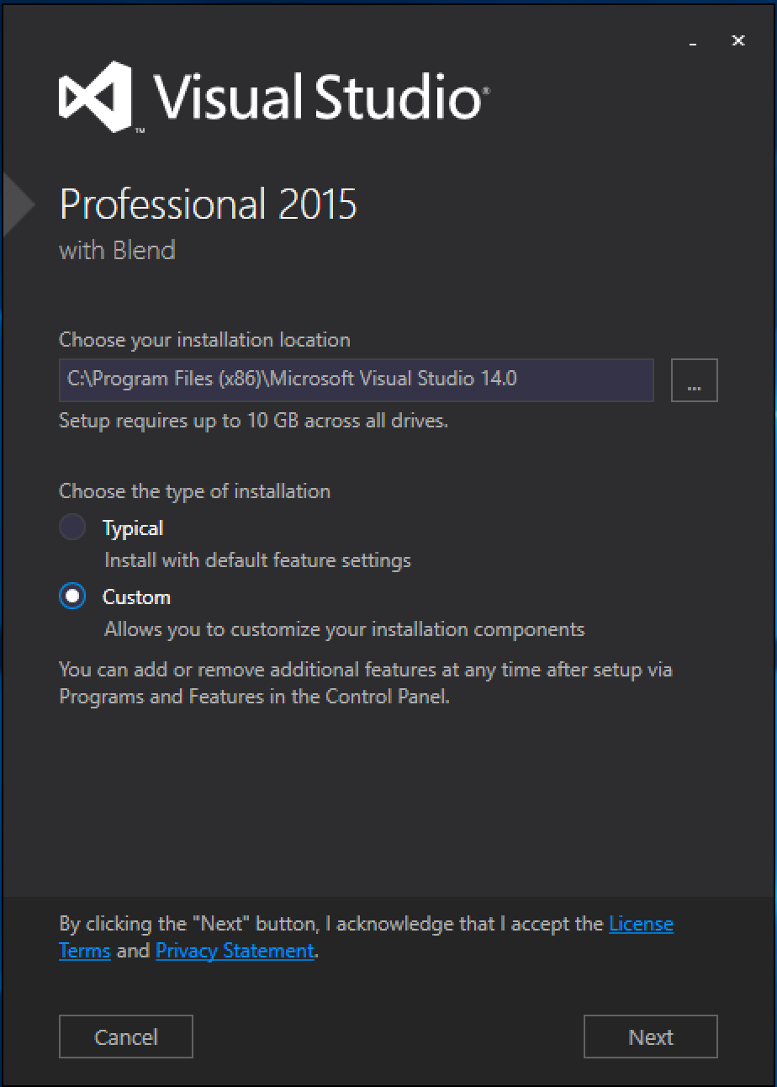
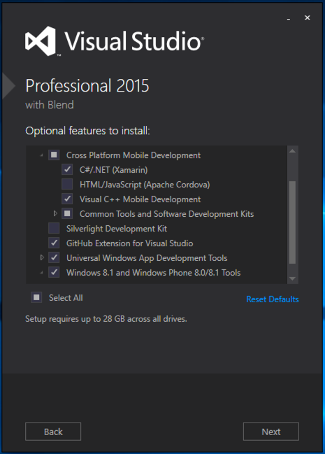
Visual Studio Integration
Xamarin.com/Download
Notes:
I highly recommend Visual Studio 2015 or 2017, when you install simple click on custom and then click C# Xamarin.

Slide 24
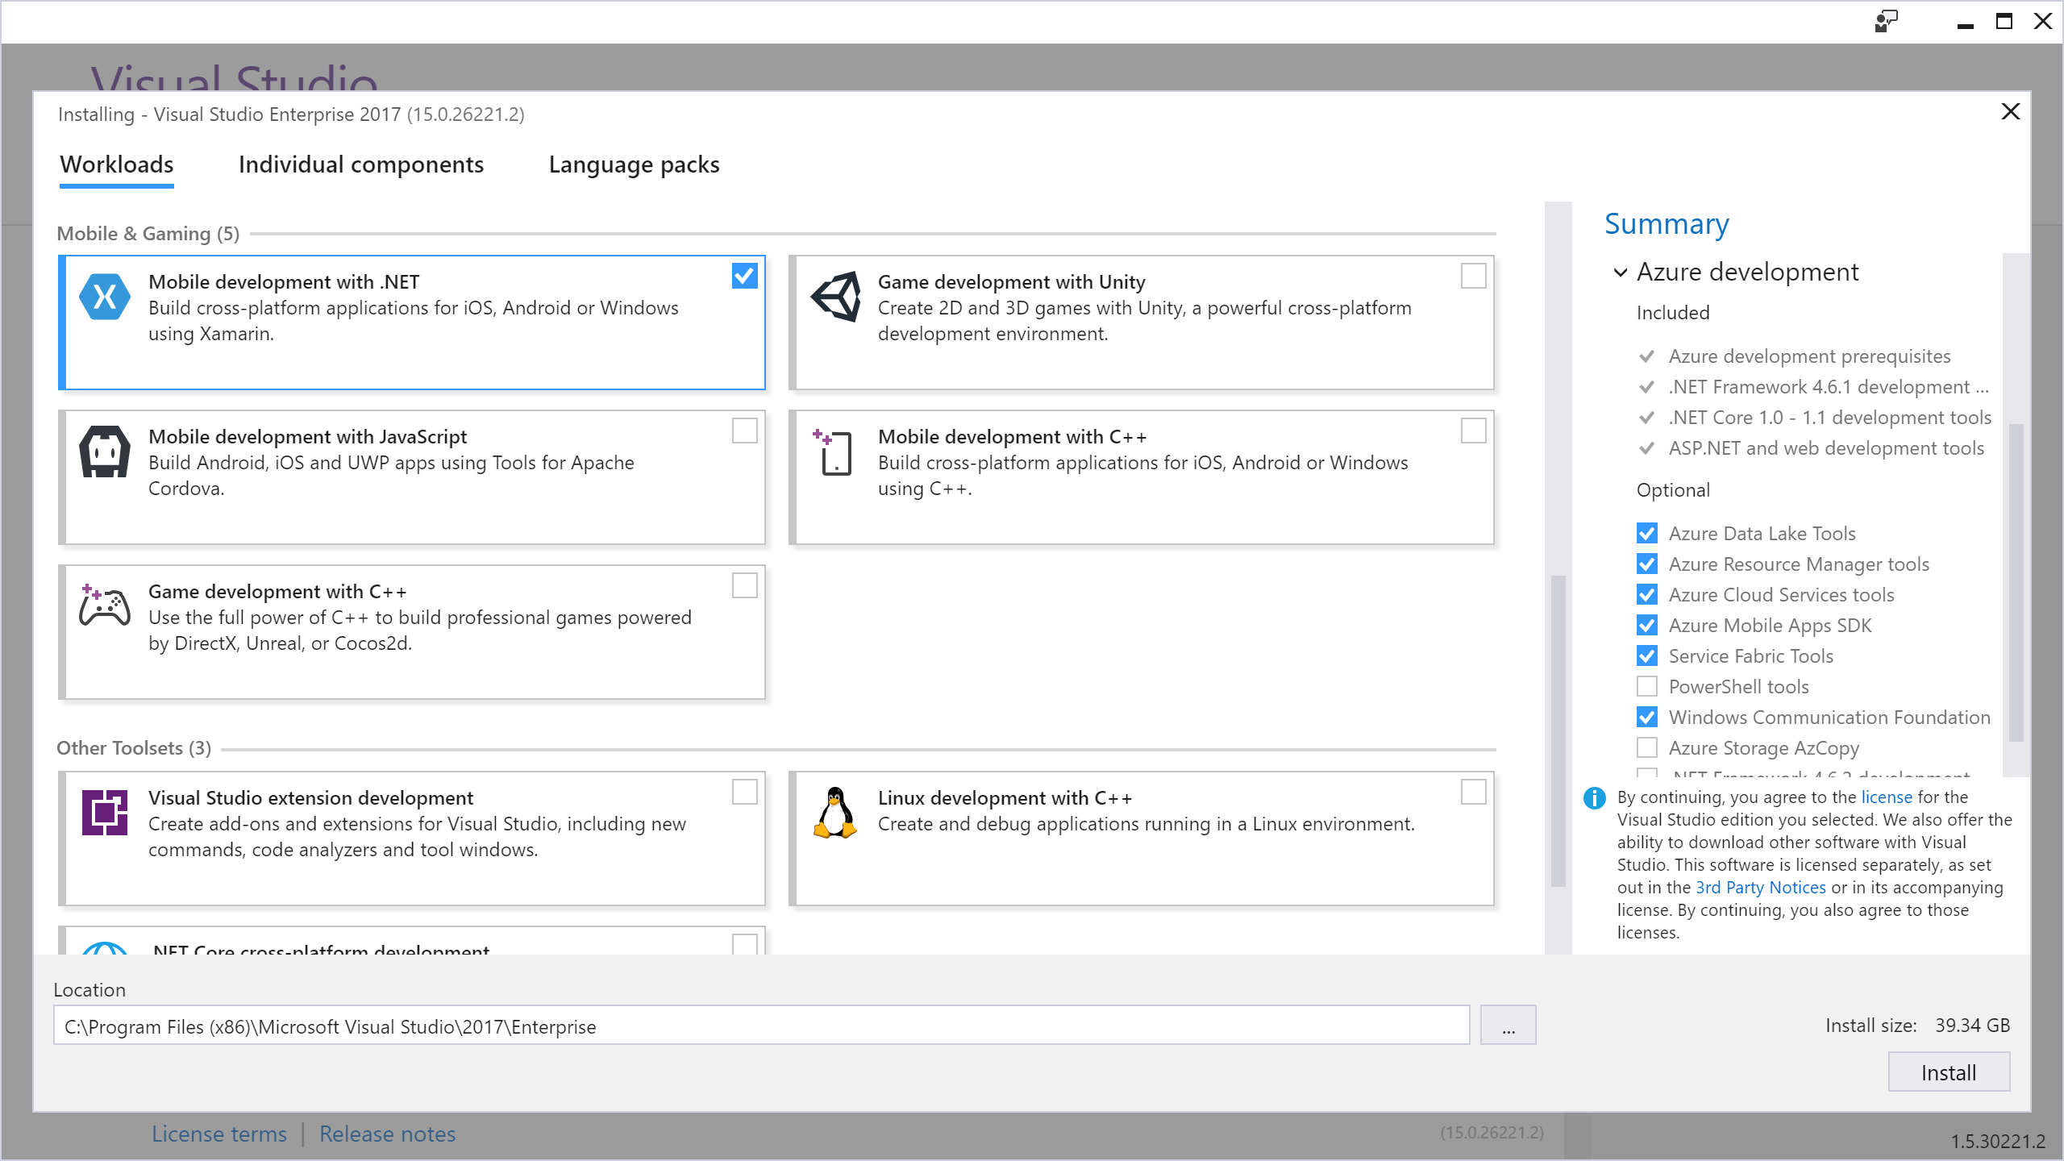
Visual Studio Integration
Xamarin.com/Download
Notes:
You are good to go with everything you need inside VS.
If mac, you can go to – Xamarin.com/Download and – download all the tools you need.

Slide 25
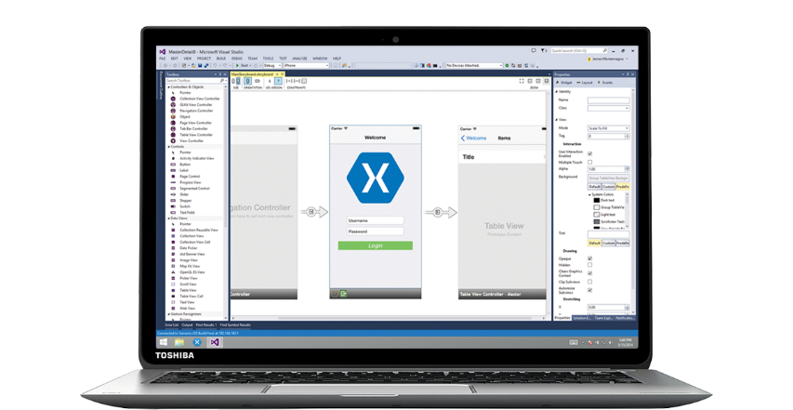
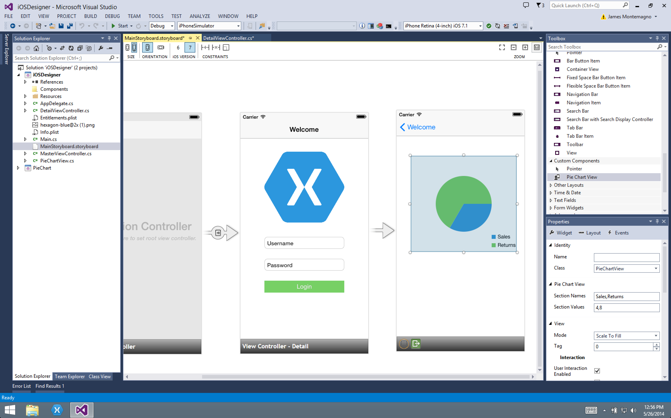
Xamarin for Visual Studio
Notes:
There is also designer for iOS build right into VS.
This video will show you all the little cool thing that you can do.
I embedded this video, just in case if anything terribly goes wrong for iOS.
So now, we can have the idea of development experience here.
So they have really optimized it for .NET developers. Double clicking on a control brings you out a click handler.
There is a property window. You can name it. You do custom controls, everything is rendered in real time which is really awesome.

Slide 26
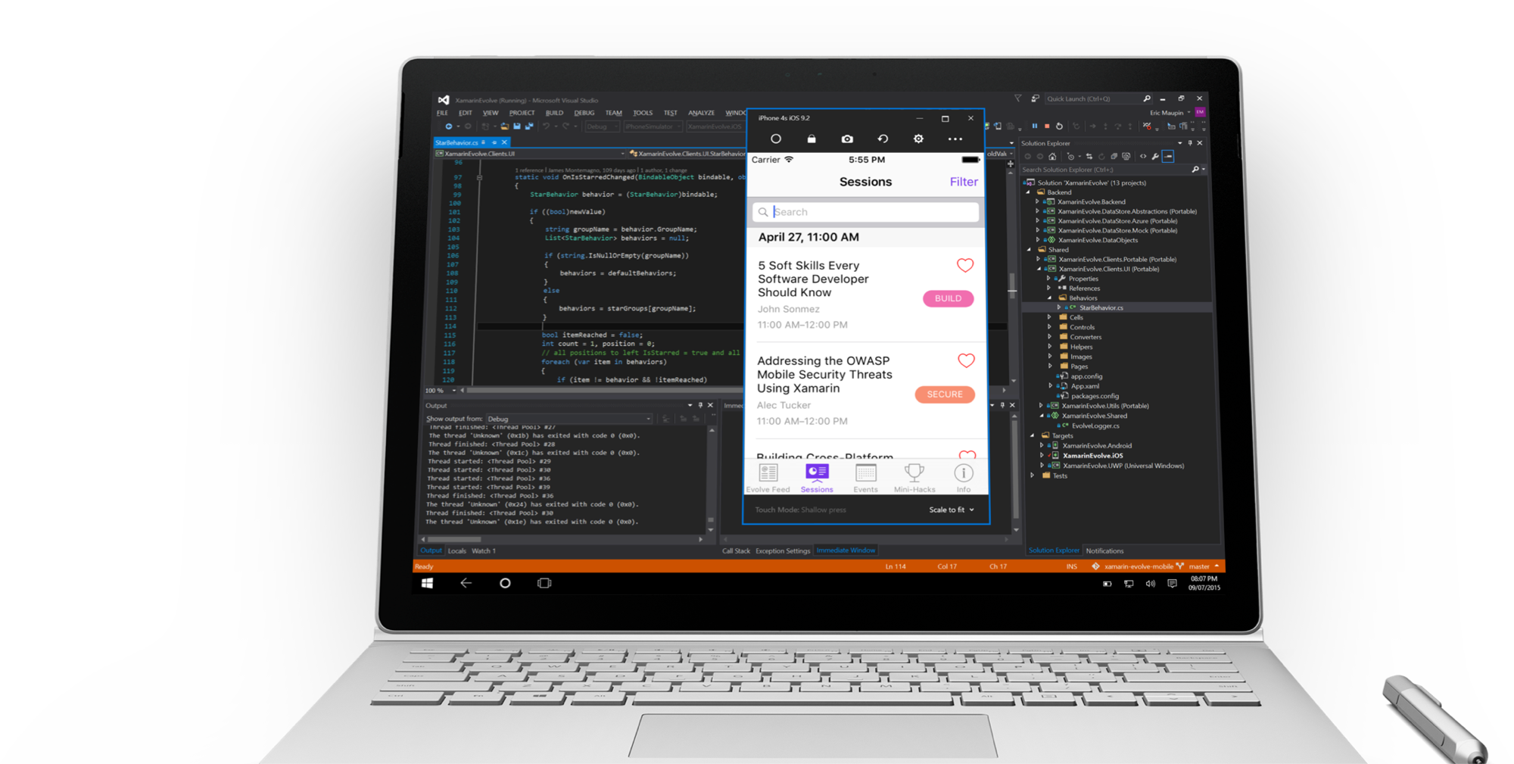
Visual Studio iOS Simulator Remoting
Multi-Touch Enabled
Pressure Sensitive
Super Fast
Rotate, screenshots, location changes
Never leave VS
*Requires Visual Studio Enterprise
Notes:
Brand new iOS simulator remoting to run and debug iOS apps on windows.

Slide 27

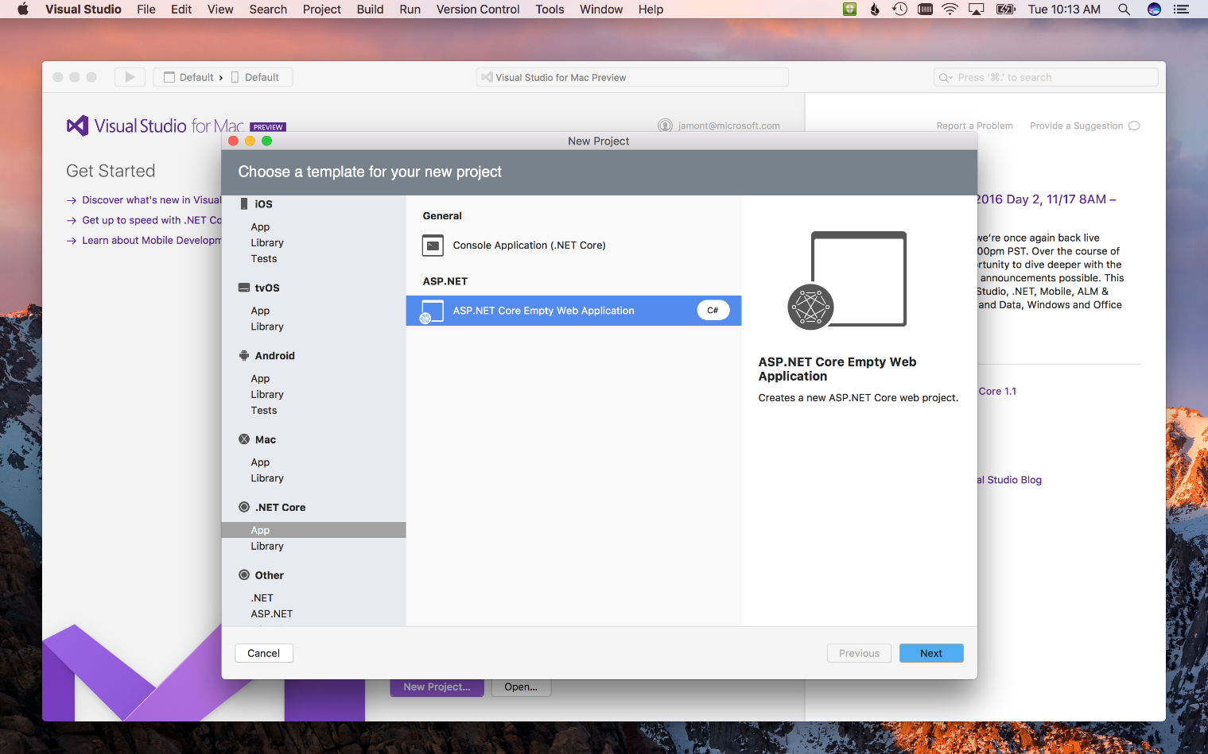
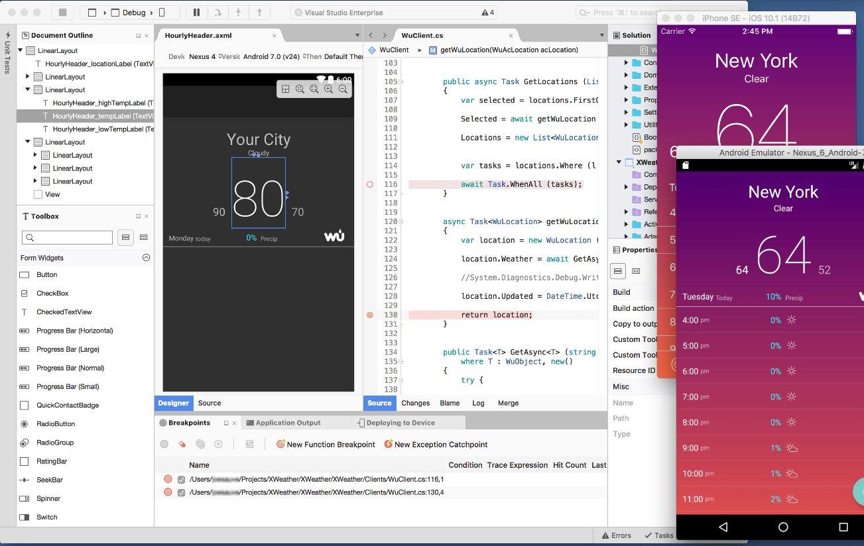
Visual Studio for Mac
iOS, Android, & macOS
.NET development
.NET Core & ASP.NET Core
Tools for Azure
Unity Game Development
Azure Functions
IoT
Docker
Notes:
If you not on a PC, you are on a mac, Don’t worry. Because Visual Studio for Mac is also available.
Free IDE. Also, community license available now.

Slide 28
Let’s Build an App

Slide 29
Streamlined Development
Notes:
One thing I wanna talk about is what happens when you wanna take it a step further.

Slide 30
Shared C# Backend
Notes:
What happens when we add these unique APIs access the native APIs on each platform?
We have the shared C# backend but whats all these stuff?
We have written only a few lines of code which is pretty impressive. Nowe what happens when you integrate these stuff into it.

Slide 31
Platform Specific Code
UI+APIs
UI + APIs
UI + APIs
Battery
GPS
Lights
Notifications
Settings
Text To Speech
Battery
GPS
Lights
Notifications
Settings
Text To Speech
Battery
GPS
Lights
Notifications
Settings
Text To Speech
What if we didn’t have to write this code?
What if we could access it from shared code?
Notes:
Things like battery, GPS, notifications, Settings.
You saw earlier that we had the ability to pop up a notification right from my shared code.
What if developers didn’t have to write these codes three different times in 3 different platform?
What if we could access this from a shared code?

Slide 32
Speak(“Hello World”);
AVSpeechSynthesizer
TextToSpeech
SpeechSynthesizer
Notes:
Say we have a speech API that exists on each platforms. So you just wanted an API called Speak and underneath it should call each platform.

Slide 33
Plugins for Xamarin & Windows
Xamarin.com/plugins
Common API
Notes:
This is where plugins for Xamarin come up with.
You will be talking a look some more during the next session accessing a single API for common APIs in all the platforms.

Slide 34





Microsoft’s complete mobile DevOps solution
Develop
Test
Build
Distribute
Monitor
Notes:
When you think of Xamarin, you often think about building applications that we are gonna talk about today. So using VS for iOS, Android & Windows development over C# and F# skills and .NET knowledge & everything on NuGet that we know allow Xamarin to provide a complete Mobile solution when you wannt go Cross-Platform mobile at all .
Apps were used for testing business logics, our Models, ViewModels like that. What about the UI?
How do we ensure that the UI’s reacting to the logic? That’s where Xamarin Test Cloud & Xamarin UI Test come in.
Complete Automated UI framework to do things that our users & doing inside apps.
And ofcourse we need something to build & deploy with. That where VS team services comes in. To build anything including Xandroid & iOS & Windows apps. That one stop shopping for everything we need.
Finally, we need a way to get our apps not to the app stores but also to the daily users & the internal testers and also our monitoring our apps. That’s where the hockey apps comes in.
A free tour from Xamarin & Microsoft that may be to Distribute your apps for free through testers – Once they are released into a while.

Slide 35
Live Update
Crash Reporting
A/B Testing
Storage
Identity
Push Notifications
Remote Config.
Tables
Notes:
So that really is Xamarin is a really a complete mobile solution from build, test, develop, distribute and monitor.

Slide 36
Visual Studio Mobile Center
A/B Testing
Push Notifications
Crash Reporting
Remote Config.
Identity
mobile.azure.com
Tables
Live Update
Storage
Notes:
So that really is Xamarin is a really a complete mobile solution from build, test, develop, distribute and monitor.

Slide 37
10 Minute Break
Harikrishnan
Product Lead – Syncfusion Inc.
harikrishnann@syncfusion.com nharishkrish@gmail.com
https://www.syncfusion.com/products/xamarin/datagrid
https://www.linkedin.com/in/hari-krishnan-304a0272
Notes:
So building our first app.
Lets take a quick 10 to 15 minutes break and we will come back and take a look at Xamarin.Forms.

